Slide 1
AMD Versal™ アダプティブ SoC: Power Design Manager
2025.2

Slide 2


目的
この章では、次の項目を学習します。
目的 01
Versalファミリの消費電力見積もりツールPower Design Manager の使用方法
目的 02
Power Design Manager を使用して電源を設計する

Slide 3
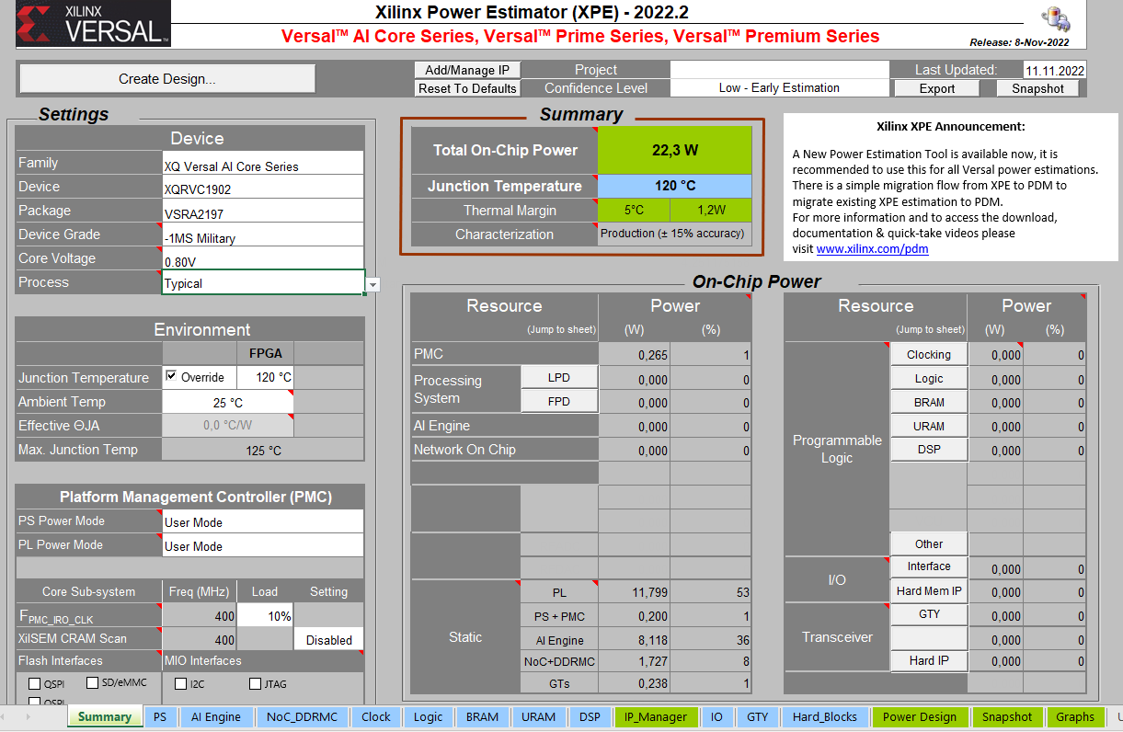
以前の消費電力見積もりツール: XPE
利点
  多くのユーザーによく知られている
  どのデザイン段階での電力の見積もりに役立つ
  熱設計に役立つ
  UltraScale+世代までの標準
課題
  XPE は Windows 10/11上でのみ実行できる
  Windows の地域設定に制約がある(US英語のみ)
  Excel マクロのセキュリティ問題の可能性
  デバイスの複雑さが大幅に増加
  巨大デバイスではExcel マクロのため計算時間が長い
  Versal™ デバイスは複雑で手間が多い。
Notes:
Power and cooling specifications for SoC and FPGA designs have to be determined early in the product’s design cycle, often even before the logic within the SoC or FPGA has been designed. An accurate worst-case power analysis early on helps users avoid the pitfalls of overdesigning or under designing a product’s power or cooling system. The Xilinx Power Estimator tool is a spreadsheet-based tool that helps you achieve this.
XPE estimates the power consumption of a design at any stage during the design cycle. It accepts design information through simple design wizards, analyzes them, and provides detailed power and thermal information. This tool is tightly integrated with the Vivado™ Design Suite.
Advantages of the XPE tool include the following:
The XPE tool is well known to many users. It was introduced for the Virtex™ ­4 family and evolved to support subsequent architectures as well.
The XPE tool can be used at any design stage. This allows for starting from scratch without any design data, using it for parts of a design, or running final power estimations on a complete design.
Furthermore, the XPE tool is helpful for obtaining basic information on the thermal characteristics of a design.
Finally, the XPE tool is the standard power estimator for previous silicon generations.
However, we now have Versal devices with much higher complexities and performance per Watt than previous silicon generations. Other challenges with the XPE tool include the following:
Many users are on operating systems other than Windows.
Windows supports various languages and regional settings. There are potential issues with U.S. vs. European decimal dot or comma notations.
The XPE tool uses Microsoft Excel with macros to calculate power. Users have reported problems not with the XPE file but with how Excel handles macros. Microsoft security updates can also cause form controls, macros, or ActiveX controls to stop working in Excel.
Device complexity has increased significantly over the last few years. This results in more complex power-related decisions and calculations. This slows down the Excel macros dramatically.
Even if you could still use XPE for Versal devices, working with the tool is no longer user friendly.
We now have a tool that is recommended for power estimation for Versal devices. This is the Power Design Manager.

Slide 4
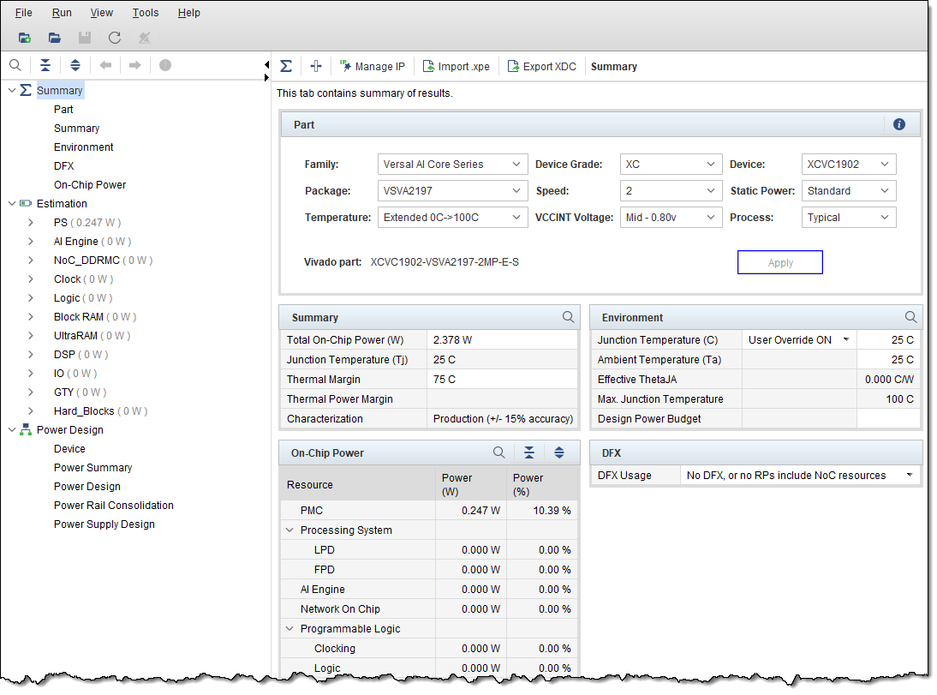
PDM の概要
[Summary] タブ
パート詳細
[Estimation] タブ
環境に関する詳細
[Power デザイン] タブ
消費電力サマリ
詳細
オンチップ消費電力の詳細
Notes:
This is the graphical user interface of the PDM tool.
In the left pane, there is the Summary, Estimation, and Power Design tabs. Note that the resources in the Estimation tab depend on the Versal™ device selected.
When the Summary tab is active, the right panel shows:
The details to the part settings. This section summarizes the device selection and the process settings for power estimation. You can change them in real time to see the impact on total power.
The environment settings. This allows you to either force the junction temperature to a fixed value or specify the maximum ambient and effective ThetaJA for the thermal solution.
The power and thermal summary. This read-only table shows the total power estimation, junction temperature (Tj), and margin based on the environment table.
In addition, block-wise dynamic and static power consumption of a design is provided in the On-Chip Power section.
Clicking the Estimation or Power Design tabs will reveal their specific panels.

Slide 5
PDM のインストール
OS 要件
Windows 10/11 および Linux 64 ビット オペレーティング システム
インストール手順
AMD 統合インストーラーの一部になっている
1.インストール ファイルをダウンロードする
    https://www.xilinx.com/support/download.html
  2.インストーラーを起動する
    Xilinx_Unified_<version>_<OS>.exe を実行する
  3.インストール ウィザードに従う
    PDM を選択する
    すべてのライセンス契約に同意する
    デスティネーション ディレクトリを定義する
Notes:
The Power Design Manager tool is supported on the Windows 10 and Linux 64-bit operating systems.
Here are the installation steps. Note that you must be registered to download the tool.

Slide 6
デザイン エントリ オプション
PDM のデザイン エントリは、次のように分類されます。
デザインの作成
デザイン解析
デバイスを選択して設定する
IP ウィザードまたはタブを使用して新しいデザイン ブロックを追加する
Vivado™ Report Power から Versal™ デバイス デザインをインポートする
「what-if」分析を実行する
Notes:
Design entry in PDM is classified into the following two categories:
Design creation represents complete manual entry for power estimation. It starts with proper device selection, followed by thermal condition specifications and more importantly, configuring the platform management controller. After the design is configured, IP wizards can be used to create the designs, followed by refinement on individual block sheets.
Design analysis is specific to Versal device designs, which are created in the Vivado IDE and imported into PDM for further analysis or post processing.

Slide 7
デザイン フロー
PDM は、次の 2 つの主要なデザイン フローをサポートしています。
手動見積もりフロー
推定されたデバイス リソース数とトグル レートに基づく
[New Project] ウィザードがセットアップをガイドする
インポート フロー
インポートされた .xpe ファイルに基づく
.xpeファイルのセットアップデータを使用する
データのインポート オプション
XPE
Vivado™ Design Suite
Vitis™ AI 環境
.xpe ファイル
.xpe ファイル
.xpe ファイル
PDM
Notes:
PDM supports two major design flows:
The manual estimation flow is for when you are evaluating the selected device for total power based on the estimated device resource counts and toggle rates. When starting a new PDM project, a New Project Wizard guides you through the project setup.
For the import flow, you import a file generated from XPE or Vivado Report Power into PDM when creating a new project. With the import flow, architecture and device details are populated automatically from the XPE file.
When importing data, you have three options.
The first option is importing directly from the XPE tool. The XPE tool has an option to export the XPE file. This file can be used during PDM project creation. Note that Versal™ XPE tool version 2022.2 or onwards is supported only. Furthermore, you will need to ensure that the instance names used in the XPE tool are unique.
The second option is importing an XPE file generated by Report Power in the Vivado IDE. This can be done either in GUI mode (Report Power in the opened synthesized or implemented design) or via the equivalent Tcl command (report_power). This analysis can be vectorless—predicting switching activity of design nodes where no activity is specified by design constraints, or no activity is provided from simulation results. Alternatively, you can run a vector-based power analysis.
An important factor for obtaining an accurate power estimation is that the design activity needs to be realistic. It should represent typical or worst-case scenarios for data coming into the simulated block. The switching activity is described by the SAIF file. This can be generated by logic simulation. Consult UG900 for further information.
You can import the Vivado IDE-generated XPE file during PDM project creation or during the set up of the device.
The third option is importing data from the Vitis AI environment. The Vitis software platform generates an XPE file that can be imported to provide an accurate starting point for AI Engine power estimation. Once imported, all the configuration is generated, and power can be estimated more accurately compared to the manual entry mode.
The XPE file generated by the Vitis software platform, when imported, averages out vector load and memory read/write rates for a particular kernel type. For example, all the cores of a kernel type INT8 vector load and read/write rate is averaged and populated in a single row in PDM. The interconnect load is not a default of 12% in the import flow. Instead, it is computed by the tool based on the stream usage for each AI Engine tile.
Note that the simulation flow can be used to obtain more accurate power analysis of the AI Engine. To do this, the AI Engine simulator can be run after the AI Engine compiler flow.
You can import the XPE file to the AI Engine tab by using the Import option in the AI Engine Power Interface of the PDM tool.

Slide 8
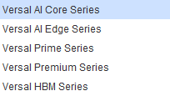

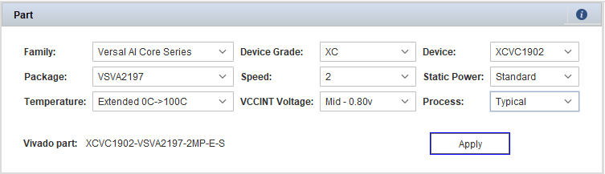



デバイスのコンフィギュレーション
Notes:
Device selection (based on resource, performance, power, and package requirements) is a crucial step for an application. The recommendation is to select the smallest device that meets your requirements.
When targeting Versal™ devices, many functions that are traditionally implemented using logic resources can be absorbed into hardened Versal IP blocks like the NoC, DDRMCs, MRMACs, and AI Engines to reduce power. Remember to subtract any logic resources absorbed into hard IP.
PDM supports the targeting of mainly Versal devices. Versal device selection includes the family, device, device grade, package, speed, temperature grade, and static screening option. The VCCINT voltage and process can also be initialized during device selection.
Each device has a unique set of functional blocks, while the package selection determines the available I/O and transceivers. For details, refer to the product selection guide of the target family.
Versal devices support the following temperature grades, each having an impact on power.
The industrial operating temperature range is –40°C to 100°C.
Extended operating temperature range is 0°C to 100°C.
Q-grade operating temperature range is –40°C to 125°C.
Military operating temperature range is –55°C to 125°C.
Our unique power binning strategy enables lower static power for industrial grade devices compared to extended grade devices. Versal devices offer enhanced voltage scaling options, which is the key for the highest performance/watt on these devices.
Versal devices support the following operating modes:
High-performance core operating voltage is 0.88V (VHP)
Mid/balanced power/performance core operating voltage is 0.80V (VMP)
Low-power core operating voltage is 0.70V (VLP)
The Process selection represents the manufacturing process variation of the device, which significantly influences leakage power.
You can set to Typical for battery powered in low operating temperature applications.
For all other use cases, set to Maximum for worst-case power estimation, which is important for power supply, board, and thermal design for high power-consuming applications.

Slide 9
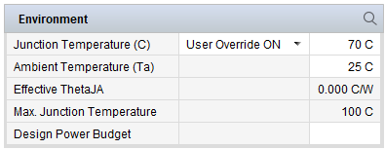
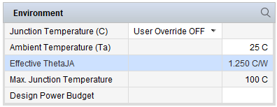
熱設定
リーク電力は、ジャンクション温度に対して急激に増加する
2 つのフロー:
  ユーザー指定のジャンクション温度
  PDM による推定ジャンクション温度
熱シミュレーションなし - ジャンクション温度の計算のみ
ジャンクション温度 = 周囲温度 + (実効熱抵抗 * オンチップ消費電力合計)
推奨事項: PDM によって設定された最大有効 ΘJA を、決定された有効 ΘJA に置き換える
温度勾配マージンを超えた場合のアラート
Notes:
Leakage power increases exponentially with respect to junction temperature, so it is very important to accurately specify the environment conditions in PDM.
The environment settings allow the following flows:
For user-specified junction temperature, enter the targeted junction temperature or the maximum junction temperature of the device and ambient temperature. PDM calculates maximum effective ΘJA to meet requirements (the Effective ΘJA field is read only).
For PDM-estimated junction temperature, enter the ambient temperature and effective ΘJA from which PDM calculates the junction temperature. You can derive the effective ΘJA from the thermal simulation.
PDM does not perform thermal analysis to calculate the effective ΘJA. It reports the requirements based on the given junction temperature and ambient temperature values. PDM uses the thermal settings only to calculate the junction temperature based on the formula shown here.
It is recommended that you replace the PDM-populated maximum effective ΘJA with the determined effective ΘJA from thermal analysis of the system, preferably from the thermal simulation or an actual system measurement.
PDM alerts you if the specified or calculated junction temperature exceeds the device temperature grade margin.

Slide 10
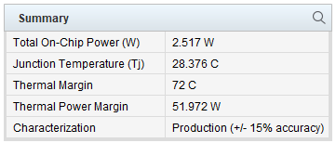
熱のサマリ
消費電力および熱のレポート
Notes:
The Power and Thermal dashboard is very similar to XPE. The Characterization label indicates the characterization status of the selected device.
The figure here shows a summary of power and thermal reporting for the VC1902 device in the VSVA2197 package for static power only. Based on previous environment settings, the thermal power margin is about 50 W for the functionality.
Thermal and power margins are measured against the maximum accepted ranges for this device grade. Thermal margin is negative when the estimated junction temperature exceeds the maximum specified value for the device.

Slide 11
PL エレメントの消費電力見積もり
プログラマブル ロジック
ロジック
ブロック RAM/
UltraRAM
DSP
I/O
トランシーバ
クロックの定義から始める
ストラテジの見積もり
各主要な階層デザインブロックに対応するリソースの
行を入力する
各階層ブロック内のクロックごとに、少なくとも 1 行の
リソースを入力する
ロジックとそれに関連付けられたクロックをグループ化する
異なるトグルレートのリソースに対して複数の行を使用する
Notes:
The programmable logic consists of the following components: logic, block RAM, UltraRAM, DSP, I/O, and transceivers.
You should define the clocks first so that they can be associated with the resource entries on the other sheets.
The organization of data entries is important for accurate power estimation. This lets you avoid underestimation resulting from parts of the design being overlooked as well as avoid overestimation by duplication.
Use the following common strategy for estimating the power of large designs:
Enter rows of resources corresponding to each major hierarchical design block, using the block name or instance name as a base name for the row
Enter at least one row of resources for each clock within each hierarchical block
For logic on clock domain crossings, group the logic with its associated clock
Within each clock domain, use multiple rows for resources with different toggle rates

Slide 12
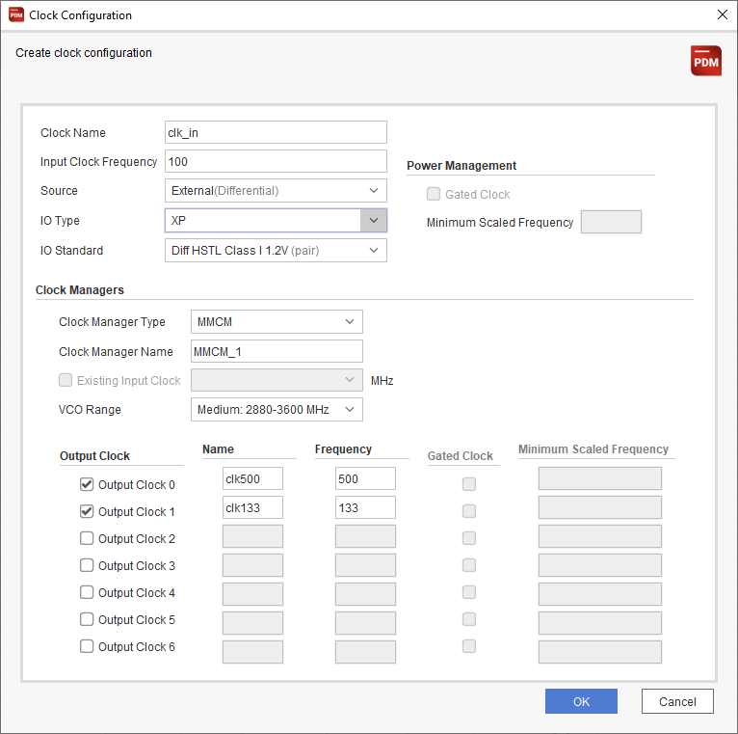


クロックの見積もり
すべてのクロックを定義する
利用可能なウィザード:
既存のクロックを編集または
削除する:
GUI は使用率と消費電力に
関するパネルを提供する
Notes:
In the estimation flow, start with defining the clock networks used in the design.
The PDM tool offers a wizard for creating clocks. The figure here provides an example for clock configuration.
In the analysis flow, you can use the Edit Clock tab to modify imported clock nets. You can delete clocks from here as well.
Once the clock configuration is done, you can observe the utilization (the number of clock elements available and used are given as well) and power dissipation of the voltage rails involved.

Slide 13












電力見積もり
ロジック
ブロック RAM
/UltraRAM
DSP
I/O
トランシーバー
AI エンジン
ハード ブロック
プロセッシング
システム
NoC および強化されたメモリ コントローラー
Notes:
Let’s now look at the power estimates in detail.

Slide 14
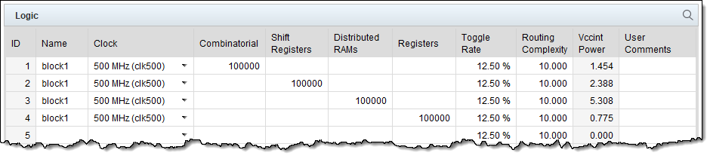

ロジックの見積もり
CLB ロジックの消費電力見積もり: LUT とレジスタ
行はそれぞれ次に関連するロジックのグループを示す:
  ダイナミック消費電力の計算に使用されるクロック周波数
  すべてのロジックの入力と出力の平均を表すトグル レート
LUT の違い:
  組み合わせロジック
  シフト レジスタ
  分散 RAM
利用可能なウィザード:
Notes:
The Logic tab covers power estimates of CLB logic: LUTs and registers.
Each row represents a group of logic that is associated with:
A particular clock whose frequency is used to calculate dynamic power.
A toggle rate that represents an average over the inputs and outputs of all logic.
LUTs fall into the following three categories, while registers are primarily the CLB registers.
LUTs as combinatorial logic: For simplified entry, PDM assumes an average-sized LUT of about five inputs and also assumes a small percentage of LUTs use two outputs.
LUTs as shift registers: SRL primitives
LUTs as distributed RAMs: LUTRAM primitives
To eliminate the difficulties of estimating the total LUTs used for distributed RAM-based memories, click the Add Distributed Memory button to launch the PDM Memory Configuration Wizard.
The Routing Complexity column in the Logic tab is an abstract model of the interconnect power. The number represents the average number of routing resources per logical net. Routing complexity is typically only modified when Vivado™ power analysis results are imported. For early estimation, we recommend that you leave routing complexity at the default setting.
Once the logic configuration is done, you can observe the utilization (the number of logic elements available and used are given as well) and power dissipation of the voltage rails involved.

Slide 15
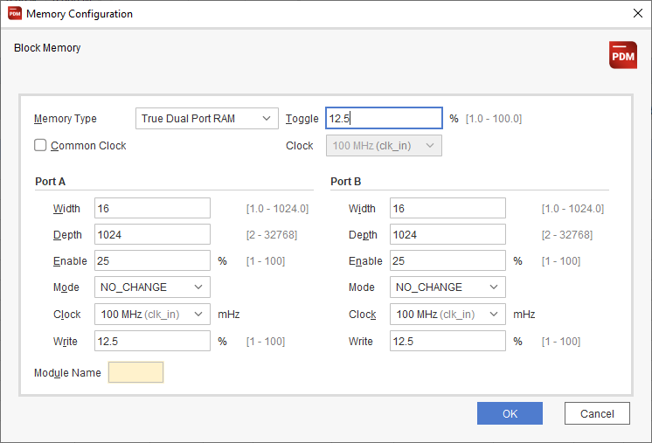

ブロック RAM/UltraRAM の見積もり
BRAM/UltraRAM の消費電力見積もり
利用可能なウィザード (ブロック RAM のみ):
イネーブル率を可能な限り正確に指定する
画面は、BRAMのもの。UltraRAM用もあります。
Notes:
The Block RAM tab covers power estimates of the dedicated 36 kb block RAMs, which are used to implement much larger memory arrays than the memories that are feasible with LUTRAMs. Block RAMs typically comprise an array of a particular depth, width, and cascade height.
The Memory Configuration Wizard available from the Add Block Memory button is recommended for entering large arrays because it closely matches the synthesized results. Synthesis often chooses certain architectural trade-offs to balance performance, area, and power, which can be slightly different than expected.
To minimize power for RAMs, the enable logic should be designed such that ports are only enabled when necessary.
Once the block RAM configuration is done, you can observe the utilization (the number of RAMB18 and RAMB36 elements available and used are given as well) and power dissipation of the voltage rails involved.
Configuring UltraRAMs is similar, but there is no specific wizard supported.

Slide 16
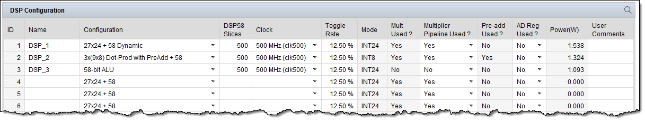
DSP の見積もり
DSP58 ブロック リソースの消費電力見積もり
仕様は XPE と同様
Versal™ デバイス DSP ブロック:
  様々な算術関数および論理関数をインプリメントする
    より広い 27x24 乗算器
    より広い 58 ビット アキュムレータ
  浮動小数点の加算と乗算をサポートする
Notes:
The DSP tab covers estimation of DSP58 block resources.
Similar to previous generations, a Versal device DSP block can implement a wide variety of arithmetic and logical functions, ranging from addition, subtraction, multiplication, and common DSP functions, such as multiply accumulate.
Like previous generations, the DSP blocks can also implement wide logic functions, such as XOR, and can be cascaded to form digital filters. The Versal device block has a wider 27x24 complex multiplier that can also be configured as three 9x8 multipliers and has a wider 58-bit accumulator.
Versal device DSP also supports floating-point addition and multiplication.
Once the DSP block configuration is done, you can observe the utilization (the number of DSP58 elements available and used are given as well) and power dissipation of the voltage rails involved.

Slide 17
I/O 見積もり
XP および HD バンクの I/O 消費電力見積もり
仕様は XPE と同様
推奨事項
  パフォーマンス目標を満たす電流最小を選択する。
  各方向を別々の行に配置する
  差動 I/O ペアの場合は、1 つのピンに入力する
  出力イネーブルを現実的な値に設定する
他のタブのウィザードは、ここにパラメーターを入力できる
  例: DDRMC はこのタブにポートをリストする
PDM ウィザードはこのタブに I/O ポートを追加可能
Notes:
With higher switching speeds and capacitive loads, switching I/O power can be a substantial part of the total power consumption of a Versal™ device. Hence, it is important to accurately define all I/O-related parameters. From the I/O tab, PDM helps you calculate the power for your I/O interfaces.
Specifying the I/O is similar to the XPE tool. There are I/O settings, activity, and external termination parameters characterizing the I/Os.
You should consider the following recommendations:
To minimize power on output signals, always use the weakest driver settings that meet your performance goals (lower the drive strength and slew rate).
Because toggling activity of inputs and outputs is often very different, it is recommended that you place each direction on a separate row.
Enter one pin for each differential I/O pair. For example, if your memory has four differential DQS pairs, enter 4 for the Input Pins column.
Setting output enable to 100% is a common mistake, which degrades the PDM accuracy.
Note that some functional blocks include I/O ports. In these cases, the specific PDM wizard adds the I/Os of a block in this tab. Therefore, run the wizards before you specify other I/Os.
Once the I/O configuration is done, you can observe the utilization (the number of I/Os and memory controllers available and used are given as well) and power dissipation of the voltage rails involved. A table also lists how many banks use which VCCO.

Slide 18
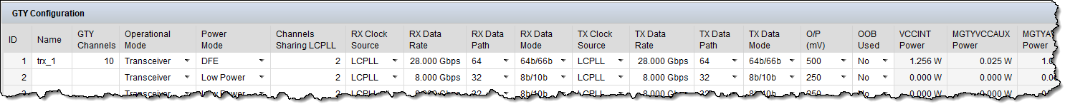
トランシーバの見積もり
Versal™ トランシーバの消費電力見積もり
GTY と GTM ではタブが異なるが、構造は同じ
利用可能なウィザード:
トランシーバは次のように指定可能:
  [Configuration] タブで手動で行う
  [Create GTY / GTM] ウィザードを使用する (PCIe® モード)
  トランシーバを使用してハード ブロックを指定する
Notes:
GTY, GTYP, and GTM are the serial transceivers used for serial data transmission in the Versal devices.
Depending on the device you are using, the Estimation tab may list GTY, GTYP, and/or GTM tabs.
You can specify transceivers by using the wizard or you can specify the transceivers manually. The figure shows an example.
Note that other wizards, such as the Hard IP Wizard, may add rows here.
Once the transceiver configuration is done, you can observe the utilization (the number of transceiver channels available and used are given as well) and power dissipation of the voltage rails involved.

Slide 19
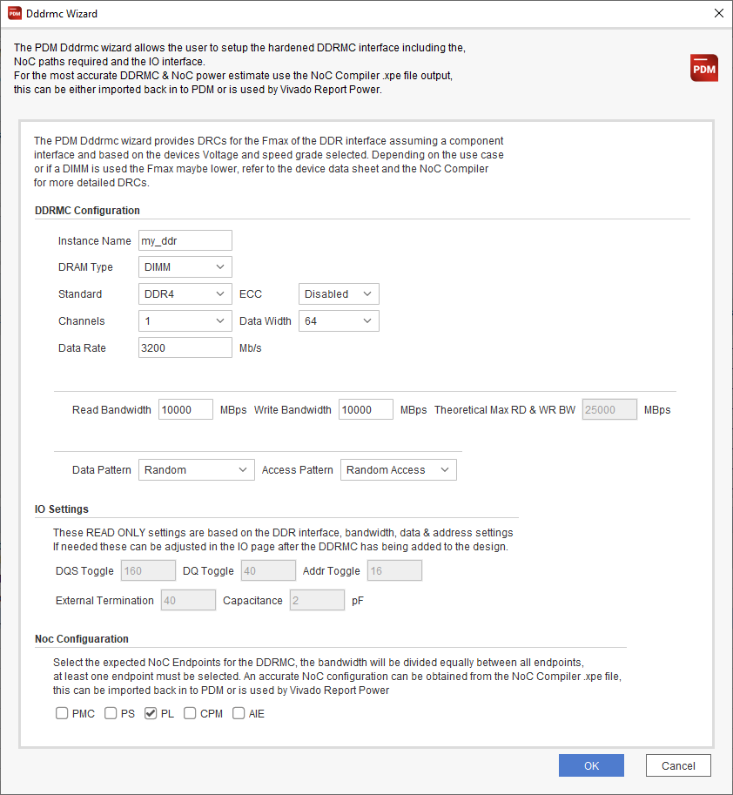
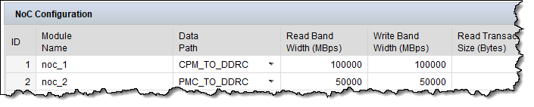



NoC および強化されたメモリ コントローラーの見積もり
NoC および DDRMC/HBMMC メモリ コントローラーの消費電力見積もり
コンフィギュレーション オプション:
手動 NoC コンフィギュレーション
DDRMC/HBMMC ウィザード
NoC コンパイラの消費電力情報ファイルをインポートする
Notes:
The network on chip is a connectivity hard block in the Versal™ architecture that replaces some aspects of the fabric and fabric logic with a narrower high-speed network. It provides connectivity between the PMC, DDRMC, CPM, PL, AI Engine, and PS. It also provides a configuration function to the blocks that it interfaces with.
The NoC and the hardened memory controller can be specified by:
Manual configuration: Use the NoC Configuration tab to specify the data paths with read/write bandwidths and transaction sizes. The figure shows a NoC configuration example.
Using the wizards: If you select the NoC/DDRMC/HBMMC tab, the menu bar offers the use of two wizards. Use the wizards to specify the external memory interface. An example configuration for the DDRMC is shown in the figure on the right. Note that once you specify a memory interface, the I/O tab will be updated automatically.
Importing a NoC compiler power information file.
The DDRMC, NOC, and HBMMC panes list the specified modules and their power dissipation.
Once the NoC and/or DDRMC configuration is done, you can observe the utilization (the number of resources available and used are given as well) and power dissipation of the voltage rails involved. The number of NoC buffers and their power dissipation is also provided.

Slide 20
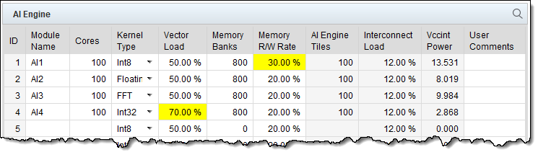

AI エンジンの見積もり
AI ツールの消費電力見積もり
見積もりフロー: [AI Engine] タブに入力する
インポート フロー:
BFloat データ型の追加サポートを備えた AI Engine-ML コンピューティング タイル
Notes:
The AI Engine tab covers the AI engines. The AI Engine array introduced in the Versal™ architecture caters to solutions for high compute or complex, DSP-intensive applications.
For an early power estimation, you should provide the configuration details of the AI Engine array, such as clock frequency, number of cores, kernel type, and the vector load average percentage for the cores. The supported kernel types are int8, int16, int32, and floating point. The Memory Banks and Interconnect Load fields are auto-populated based on the number of AI Engines used and can be overridden based on the application requirement. The figure here shows an example. Yellow-colored cells mark the borders of recommended values. A cell in ocher indicates a value exceeding recommendations. Consult UG1556 for more details.
For the import flow, use the Import function. The Vitis™ software platform generates an XPE file that can be imported to provide an accurate starting point for AI Engine power estimation. Once imported, all the configuration is generated, and power can be estimated more accurately compared to the manual entry mode.
AI Engine-ML (AIE-ML) is available in Versal AI Edge and a few AI Core series devices. The compute tiles are similar to AI Engine tiles with additional support for the BFloat data type. AIE-ML has additional shared memory tiles for improved performance and data movement.
Once the AI Engine configuration is done, you can observe the utilization (the number of resources available and used are given as well) and power dissipation of the voltage rails involved. The number of PL and NoC interfaces and their power dissipation is also provided.

Slide 21
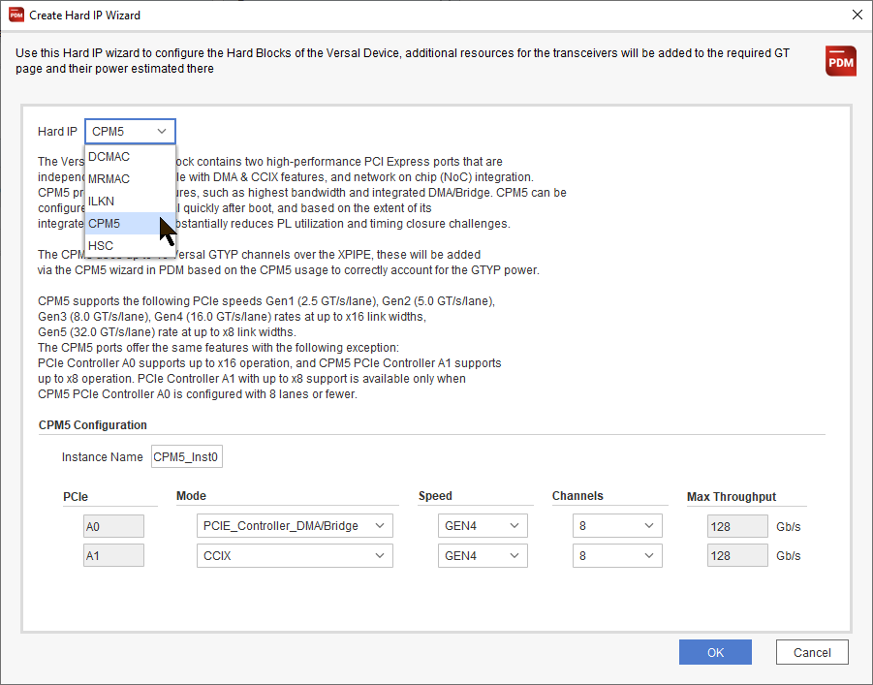

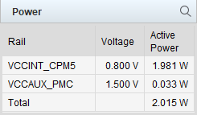
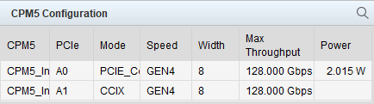
ハード ブロックの見積もり
ハード ブロック
CPM、PCIe®、MRMAC、ILKN、DCMAC、HSC
  表示されるハードブロックは、デバイスによって異なる
ウィザード
  [Create Hard IP] (Hard_Blocks サブタブ)
  [Manage IP]([Summary] タブ)
  編集と削除
他のタブもアップデートされる可能性がある (必要に応じて)
Notes:
In the Versal devices, various hardened IP or hard IPs are available. Most of these require interfacing to the GTs for I/O connectivity.
You can configure the hard IPs from the Hard_Blocks tab. Hard IP generation is facilitated through a wizard for all the hard IPs. The PDM wizard generates GTs (GTY, GTYP, and GTM) with the required link speed used in the hard blocks. The type and link speed of the GT can be selected in each wizard. Based on the link speed of the GTs and total bandwidth used for the hard IP instance, PDM automatically computes the required number of GTs.
Editing and deleting IPs are also wizard based—that is, the configuration cannot be overwritten manually on individual cells. Select the Manage IP section to edit the IP configurations in the Summary tab. You will need to select the IP type and module name to modify and make changes accordingly.
The hard IP may also require additional resources; therefore, the wizard populates them in the corresponding tab.
The figure here shows the Create Hard IP Wizard dialog box. After configuring the interface, click OK.
You can then verify the configuration in the Configuration tab, and the Power tab lists the power rails with their voltage and wattage.

Slide 22
プロセッシング システムの見積もり
消費電力見積もりドメイン
低消費電力ドメイン
フル消費電力ドメイン
プラットフォーム管理コントローラー (PMC)
Notes:
Power estimation of the processing system is split into three domains:
The low power domain
The full power domain, and
The platform management controller

Slide 23
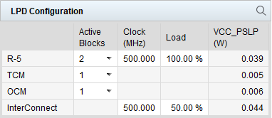
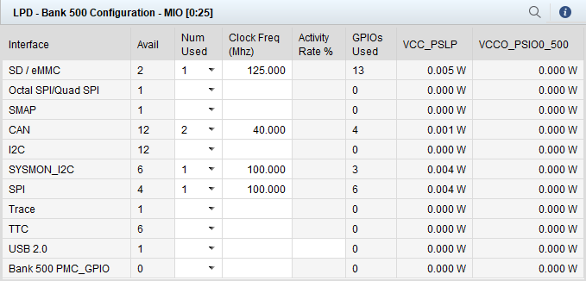
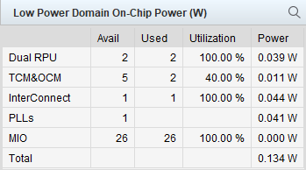
プロセッシング システムの見積もり
消費電力見積もりドメイン
低消費電力ドメイン
フル消費電力ドメイン
プラットフォーム管理コントローラー (PMC)
Notes:
The low power domain includes the real time processors (R-5), the tightly coupled memories (TCM), the on-chip memory (OCM), and LPD interconnect. Use the LPD Configuration pane to define the resources used and their clock frequencies and load. Once defined, the last column lists the power contributions.
The Low Power Domain On-Chip Power pane summarizes the low power domain power dissipation. Note that you should also define the MIO pins as well.
I/O interfaces are bank-wise configurable. The maximum number of I/O pins per bank is 26.
Here, you have an example of an MIO pin definition table. The bottom row of each GPIO bank table displays the available number of GPIOs for each bank. After GPIO configuration, 0 signifies that all the I/Os of that particular bank are already used. If the I/Os exceed the I/Os available in the bank, a DRC will be issued, and you should use the GPIOs in other banks.

Slide 24
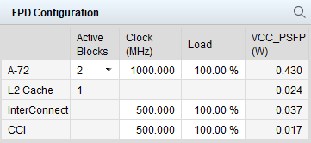
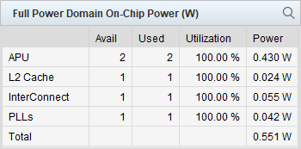
プロセッシング システムの見積もり
消費電力見積もりドメイン
低消費電力ドメイン
フル消費電力ドメイン
プラットフォーム管理コントローラー (PMC)
Notes:
The full power domain includes the 64-bit, dual-core Arm® Cortex®-A72 APU cores, the FPD interconnect, and the cache coherent interconnect. Note that L2 cache must be enabled when using the A72s. PDM does this automatically and adds power to the FPD.
The Full Power Domain On-Chip Power pane summarizes the full power domain power dissipation.

Slide 25
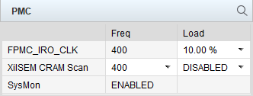
プロセッシング システムの見積もり
消費電力見積もりドメイン
低消費電力ドメイン
フル消費電力ドメイン
プラットフォーム管理コントローラー (PMC)
Notes:
PMC clock frequency is fixed and is dependent on the device speed grade. The load can be configured within the range of 0-100%.
Once the PS configuration is done, you can review the Power tab, which lists the power rails and their dissipations.

Slide 26
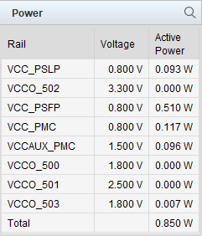
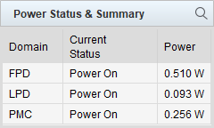
プロセッシング システムの見積もり
PS 消費電力の概要
Notes:
Finally, once you have configured the processing system, the Power tab lists all PS voltages with their voltage values and power dissipation.
The Summary tab provides the wattages of the three power estimation domains.

Slide 27
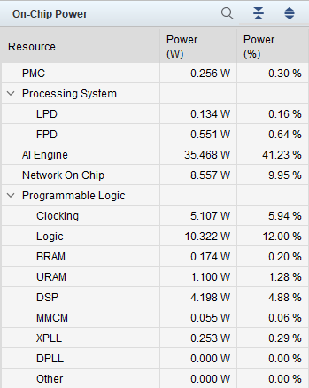
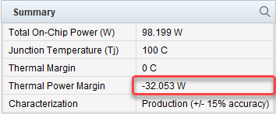
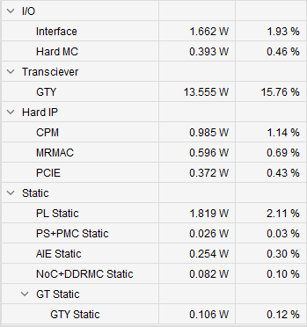
オンチップの消費電力
オプション 1
環境設定を変更する
[Summary] タブ に戻る
オプション 2
リソースの消費電力を解析する
  サマリ表を確認する
Notes:
We have now looked at all the available resources and their power characteristics. The PDM tool summarizes all their calculated power values.
For the example used in this module, if we go back to the Summary tab and check the Summary table, we can see that we are burning more power than allowed. The thermal power margin is negative. So, what can we do?
The first option is to change the environmental settings. We defined an effective Theta junction ambient of 1.25 C/W. If we can lower this value, the thermal power margin improves.
Another option is to analyze the power dissipation of the resources. Check the On-Chip Power table in the Summary section. Analyze each resource and check how to reduce the power dissipation. Start with the resources with the highest power dissipation.
This is a challenging process, requiring a lot of discussion.

Slide 28
[Power Design] タブ
[Power Design] タブの 4 つの主要なセクション:
[Device Overview]
[Power Rail Consolidation]
[Power Summary]
[Power Supply Design]
Notes:
The Power Design tab in PDM allows you to design a complete, validated power delivery solution using correct sequencing and tolerances.
There are four main sections in this tab:
1. Device Overview
2. Power Summary
3. Power Rail Consolidation
4. Power Supply Design

Slide 29
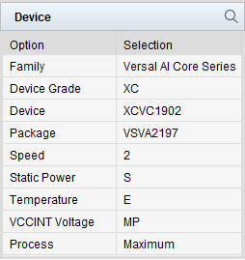
デバイスの概要
電圧、スタティック画面、温度グレードなど、現在選択されているデバイスを表示する
Notes:
The Device estimation overview section of the Power Design tab shows you the current selected device, including the voltage, static screen, and temperature grade. The power delivery should be designed for the worst-case power estimation, meaning a Maximum process with the PS and PL domains fully active.
The process can be changed from the Summary tab. At present, PDM does not allow changing the process from the Power Design tab.
The recommendation is that the power supply should also be specified for a worst-case scenario. This means that the process must be set to Maximum, and the junction temperature should be set based on the thermal simulation result. If this is not available, it is recommended to set the junction temperature to the maximum for the device temperature range.

Slide 30
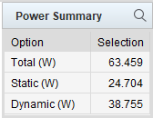
消費電力の概要
Notes:
The Power Summary section displays the total power broken down to static and dynamic.

Slide 31
電源レールの統合
完全な消費電力管理
最小電源レール
推奨
高い柔軟性
個々のレールのオン/オフをシーケンス可能
電源レールの統合
低い柔軟性
消費電力管理なし
例：次ページ
例:次々ページ
Notes:
PDM performs power rail consolidation based on the selected power delivery solution.
PDM supports the following two options for power delivery solution:
Full power management is the recommended solution. It allows for full power management, which means that individual rails can be sequenced on and off as required to reduce power.
Minimum power rails mode allows for consolidating power supplies while maintaining the required sequence and voltage specification for every rail.

Slide 32
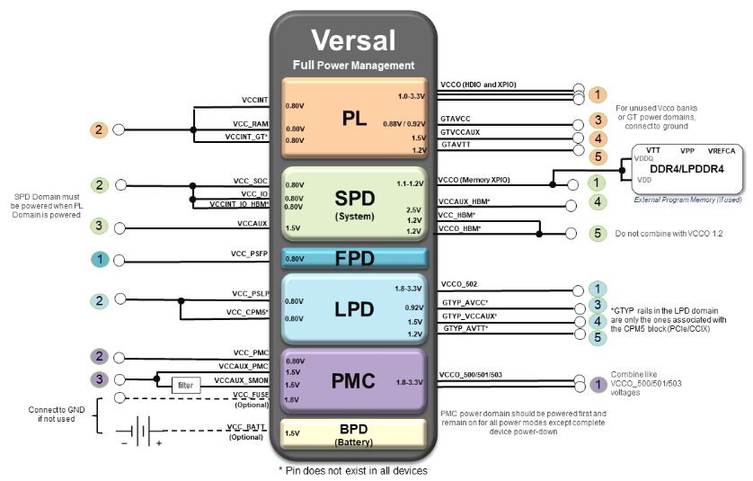

電源レールの統合
完全な消費電力管理の例

Slide 33
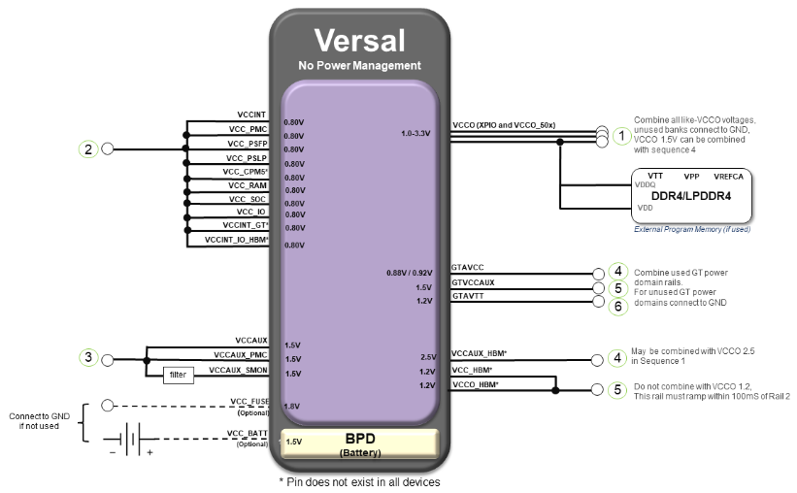
電源レールの統合
最小電源レールの例

Slide 34
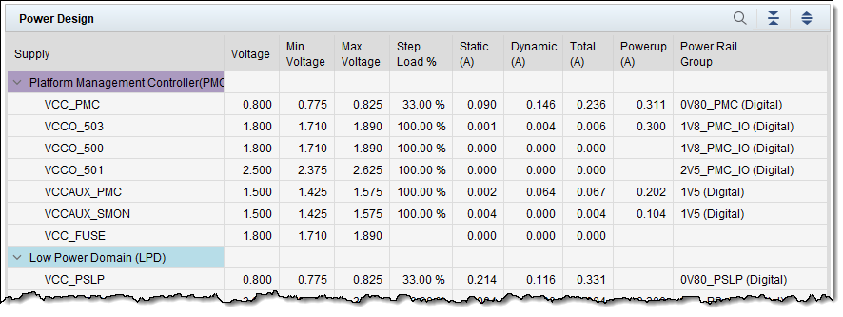
電源デザイン
最初の表には、すべての電源と電源レール グループがリストされている
Notes:
The Power Design tab displays all of the required information to correctly design the power supply and power decoupling network based on the current estimation.
The first table lists all individual supplies and power rails. All values are read only. This table provides you detailed information about all Versal device power rails. The last column assigns the individual device power rails to power rail groups depending on your power rail consolidation selections.
In summary, this table provides detailed information about all Versal device power rails.

Slide 35
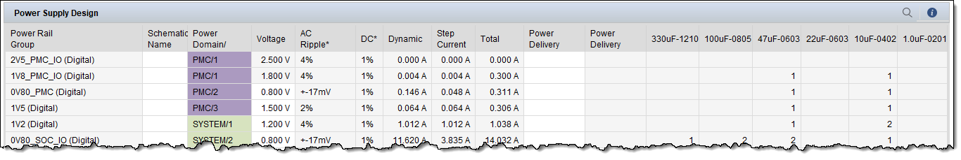
電源デザイン
2番目の表は、すべての電源レール グループを指定する
電圧、AC リップル、DC 許容値、電流を含む電源ドメイン
デカップリング キャパシタの数
Notes:
The second table specifies all power rail groups. Here you can find the voltage, AC ripple, DC tolerance, and the static, dynamic and total currents. This table also lists the number of recommended decoupling capacitors.
The Power Rail Group column is read only and depends on the power consolidation settings. In some of the columns however, you can enter your values (for example, schematic names). This information is added to the exported XML file when other power vendors or the schematic checklist are used.
It is highly recommended to keep the voltage at typical values, because this means that there is a balanced positive and negative range for the power supply design to cover AC ripple and DC tolerance.
The AC ripple and DC tolerance values only apply when the voltage is set to typical. If you adjust the voltage, then the AC ripple and DC tolerance requirements need to be re-calculated to ensure that the power rail stays within the allowed range.
In summary, this table provides detailed information about the requirements for your power supply solution.

Slide 36
電源デザイン
Versal™ デバイスの回路図消費電力スキーム
電源ドメイン、その電圧、および関連する電源
Notes:
Next is the powering scheme for either full or minimum rails. Here you can see which power supply drives which device rail.

Slide 37
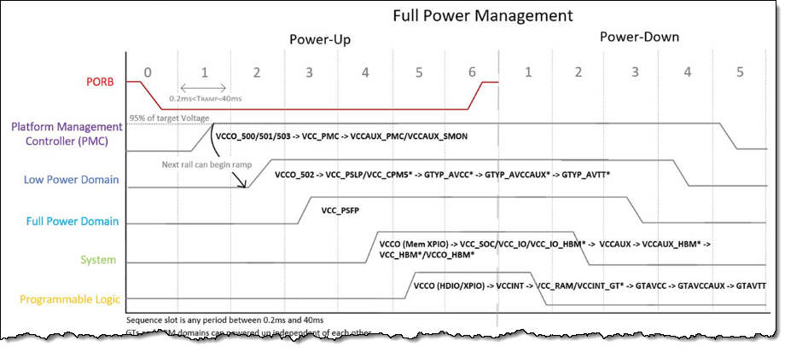
電源デザイン
電源シーケンスのスキームと詳細
グラフィカルな表現と追加の注記
Notes:
The power sequencing and powering scheme shows the order of switching up and down of the power rail groups. Additional notes are also provided.

Slide 38
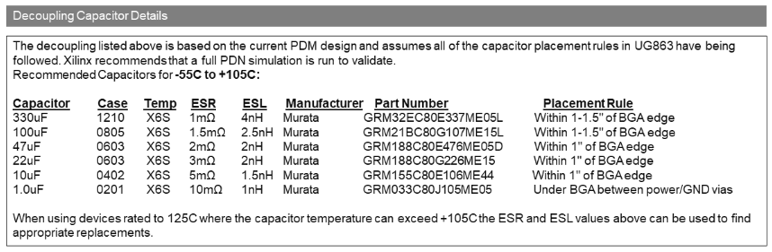
電源デザイン
デカップリング キャパシタの詳細
パッケージおよび電気仕様と配置規則
Notes:
Lastly, we have a table specifying the decoupling capacitors. The numbers are already given, but here you can find the inputs to select a specific capacitor component.
This table provides specific parts, but you can select other manufacturers once you meet the specifications given here.

Slide 39


消費電力制約のエクスポート
XDC 制約をエクスポートして Vivado™ または Vitis™ ツールをガイドし、レポートを有効にする
01
デバイス プロセス
02
ジャンクション温度
03
周辺温度
04
デザインの消費電力バジェット
05
指定の電源レール統合の電源電圧と電流バジェット
Notes:
When PDM completes the power estimation, you can export the power constraints out of PDM.
These XDC constraints are used to guide the Vivado or Vitis tools with the specified power and current budgets and to enable the reporting of any violations.
This exported XDC file has the following information:
Device process
Junction temperature
Ambient temperature
Design power budget
Supply voltage and current budget for specified power rail consolidation

Slide 40




確認問題
PDMは、XPEの置き換えで機能は全く同じです。
True
False
Notes:
Correct answer:
False.
Correct Feedback:
Yes, there is no general replacement. For the Versal™ devices, use the new PDM tool. For older devices, continue to use the XPE tool.
Incorrect Feedback:
The PDM tool is used for all Versal™ devices and a few Kria™ devices only. The XPE tool is still used for all older technologies.

Slide 41
確認問題
Versal™ デバイスに適用可能な PDM ツールの機能は何ですか?
(正しい選択肢を全て選択してください)
XPE ツールからデータのインポート
Vivado™ または Vitis™ ツールから .xpe ファイルのインポート
すべての Versal デバイス デザイン要素の消費電力見積もり
回路図デザイン用の電源スキームの提供
Notes:
Correct answer:
All of the above
Correct feedback:
Your response is correct.
Incorrect feedback:
All of these features are applicable.
Try again feedback:
Hint: There are more applicable features.

Slide 42
まとめ
01
Power Design Manger: より安定性、高速性、正確性が向上し、最大規模の Versal™ デバイスも処理できる次世代の消費電力見積りツール
02
Versal デバイス 設計のための XPE から PDM へのシームレスな移行
03
現在、Windows と Linux の両方で利用可能

Slide 43
GENERAL DISCLOSURE AND ATTRIBUTION STATEMENT
The information contained herein is for informational purposes only and is subject to change without notice.While every precaution has been taken in the preparation of this material, it may contain technical inaccuracies, omissions and typographical errors, and AMD is under no obligation to update or otherwise correct this information.Advanced Micro Devices, Inc. makes no representations or warranties with respect to the accuracy or completeness of the contents of this material, and assumes no liability of any kind, including the implied warranties of noninfringement, merchantability or fitness for particularpurposes, with respect to the operation or use of AMD hardware, software or other products described herein.No license, including implied or arising by estoppel, to any intellectual property rights is granted by this document.Terms and limitations applicable to the purchase or use of AMD’s products are as set forth in a signed agreement between the parties or in AMD's Standard Terms and Conditions of Sale.GD-18.
©2023 Advanced Micro Devices, Inc. All rights reserved. AMD, the AMD Arrow logo, Kria, Versal, Virtex, Vitis, Vivado, and combinations thereof are trademarks of Advanced Micro Devices, Inc. Arm and Cortex are registered trademarks of Arm Limited (or its subsidiaries) in the US and/or elsewhere. PCIe is a registered trademark of PCI-SIG Corporation. Other product names used in this publication are for identification purposes only and may be trademarks of their respective companies.

